Slide 1
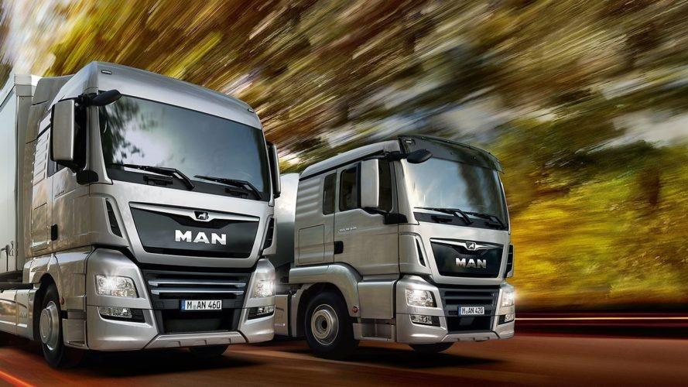

</ MAN DigitalServices Predictive Tire Breakdown>
</ CODING THE NEW>
MAN Hackathon - 12/2019

Slide 2

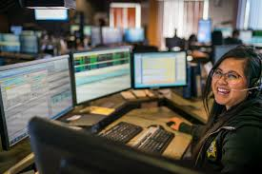
Problem of MAN’s customers:
Downtime due truck failures
Top 3 drivers of truck failures
Fleet Manager
Tire blasts
#1
Dispatcher
Brake abrasion
#2
Additional maintenance activities on defect trucks reduce fleet uptime while increasing extra repair costs and delays on customer orders.
Fuel tank issues
#3

Slide 3
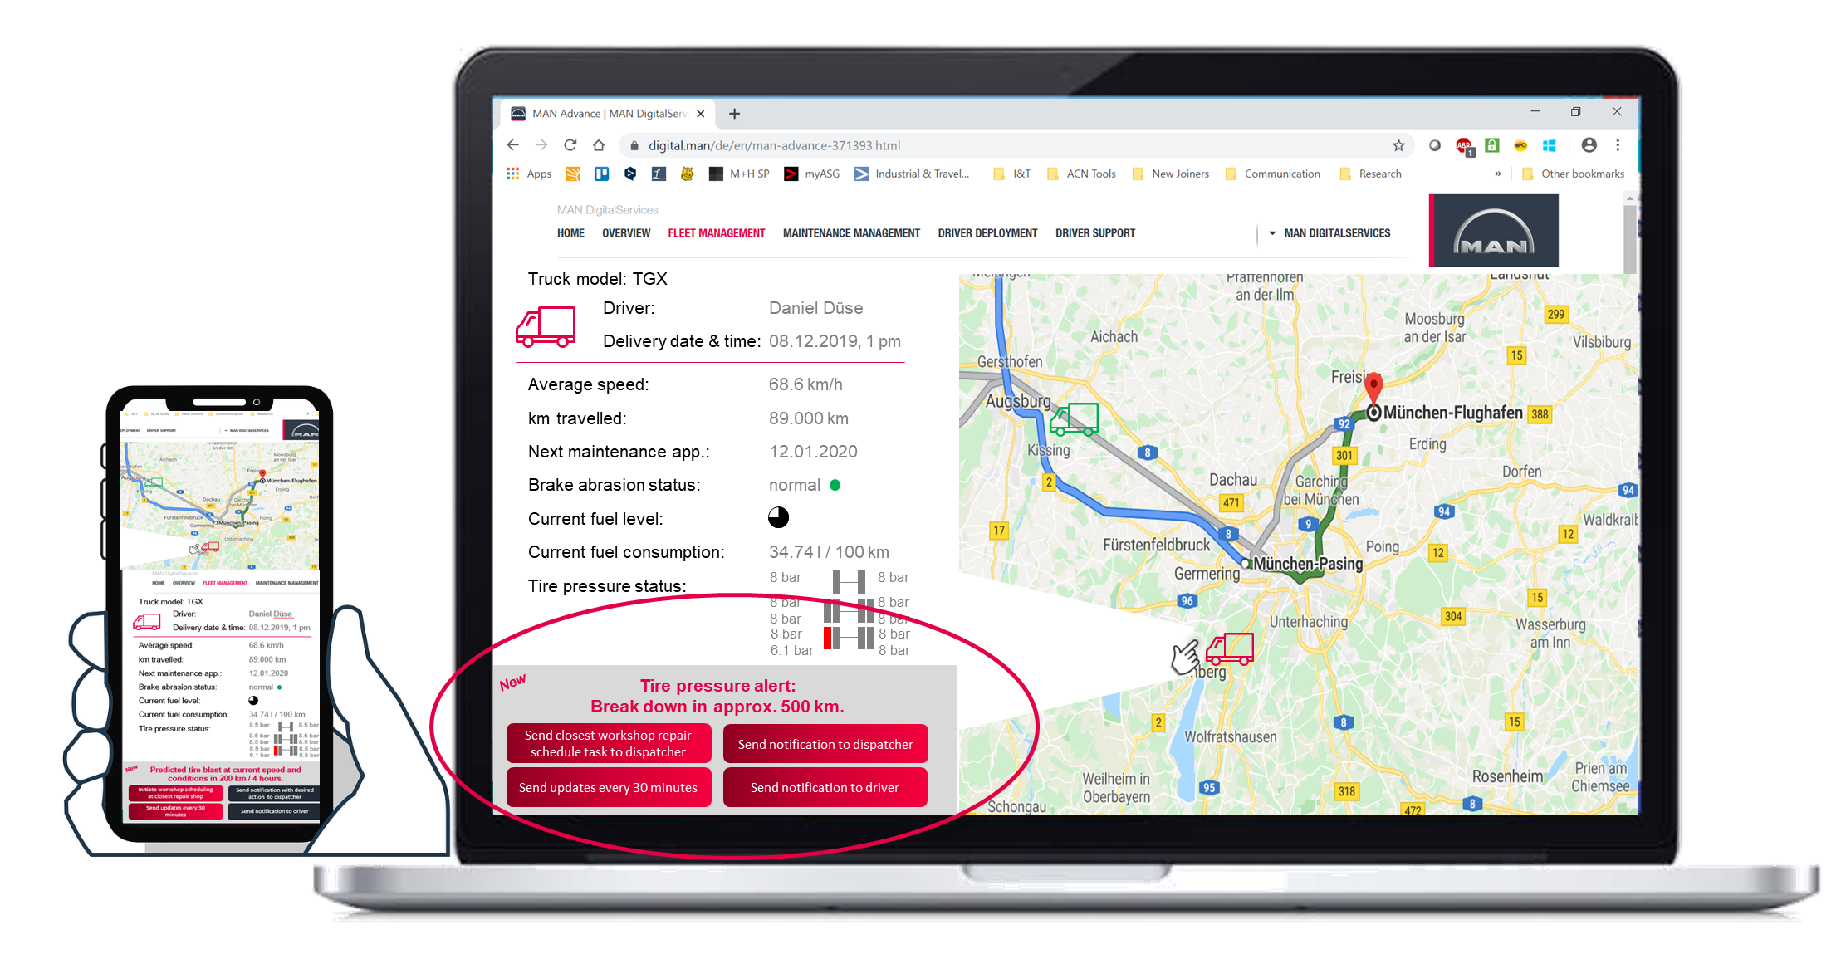
Our Solution:
MAN Predictive Tire Breakdown
Digital service offering that enables real-time notifications of tire breakdown predictions while providing suitable actions for countermeasures.
All stakeholders are informed up-to-date based on the interconnectivity of the service.

Slide 4
Our Vision:
New MAN Predictive Services
Build a modular predicitive services portfolio that improves itself through machine learning technologies, increasing fleet uptime and fleet management efficiency for MAN customers.

